Slide 1
Lead Scoring Case Study
Vishal siddharth

Slide 2
Problem statement
X Education receives a lot of leads, but its lead conversion rate is extremely low.
x education offers online courses to experts in the sector. for example, in the event that let’s say they get 100 leads a day, and only about 30 of those are converted.
The organization wants to identify the most promising prospects, or “hot leads,” in order to streamline this procedure.
The lead conversion rate should increase if they are able to locate this group of leads since the sales staff will now be spending more time corresponding with the prospects rather than calling everyone. Business objective:
1. X education wants to know which leads are the most promising.
2. They want to develop a model that can identify the hot leads.
3. Development of the model for the future use.

Slide 3
Methodology For the solution
Data cleaning and manipulation.
Check and handle redundant data.
Check and handle missing and n.a values.
Drop columns that are not relevant to the analysis and have a significant number of missing data.
Check and handle outliers in data.
Eda
Univariate data analysis, such as value counting and variable distribution.
Bivariate data analysis and correlation coefficients between the variables.
data encoding and feature scaling with dummy variables.
Classification technique: model building and prediction are done using logistic regression.
the model is validated.
Presentation of the model
recommendations and conclusion.

Slide 4
Data manipulation
there are 37 total rows and 9240 total columns.
Features with a single value, such as “magazine,” “receive more updates about our courses,” and “ update me on supply”.
chain content, “get updates on dm content”, “I agree to pay the amount through cheque” have been dropped.
Eliminating the “lead number” and “prospect id”, as they are not required for the analysis.
After looking up the value counts for a few object type variables, we discovered that some features- like “do not call,” “What matters most to you in choosing course,” “Search”, “Newspaper Article”, “X Education Forums”, “Newspaper”, “Digital Advertisement” etc.
Eliminating the fields like "Lead Profile" and "How did you hear about X Education" that have more than 35% of their values missing.

Slide 5
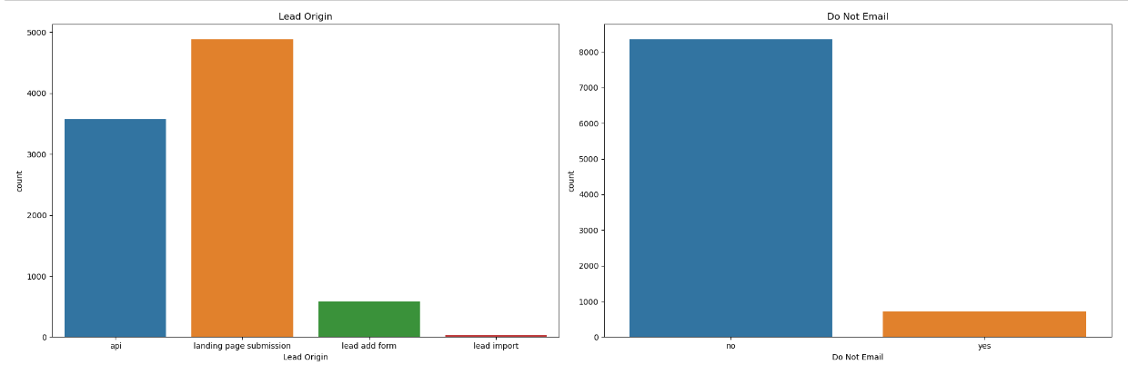
eda

Slide 6
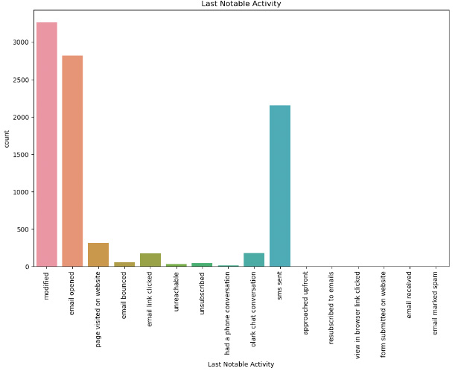
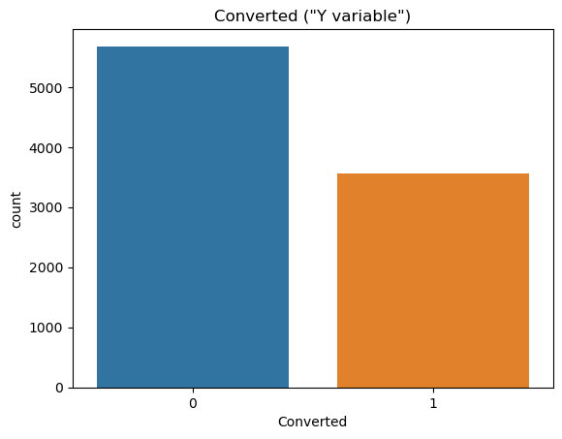
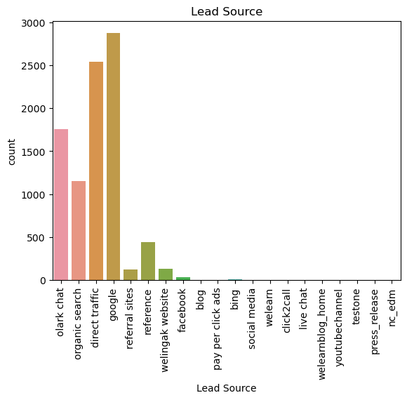

Slide 7
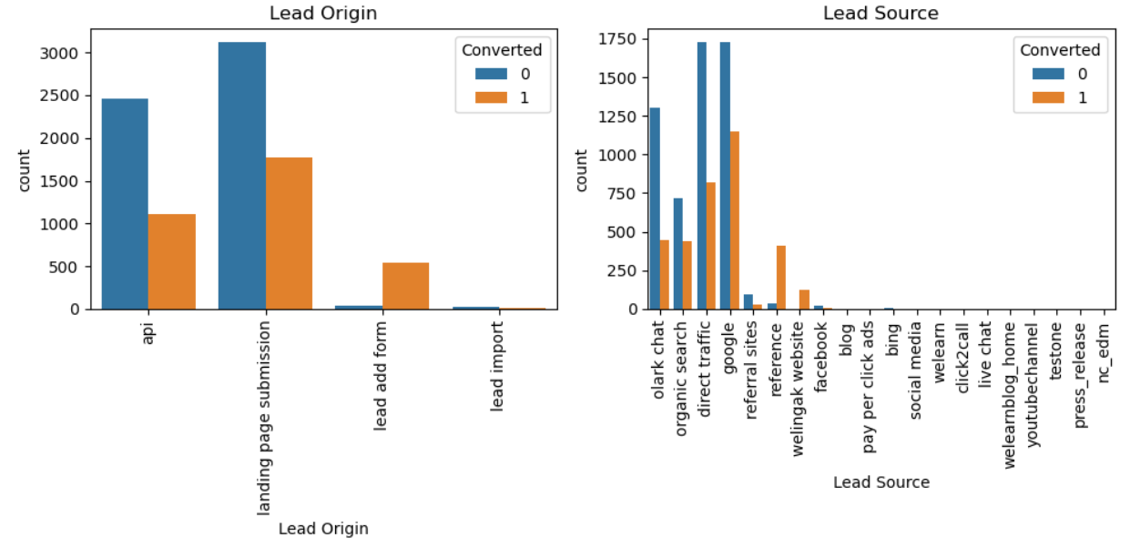
Categorical variable

Slide 8
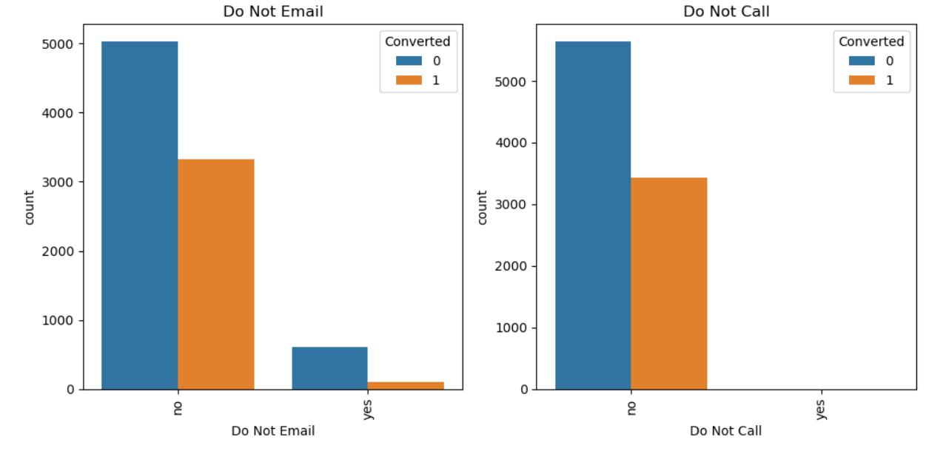

Slide 9
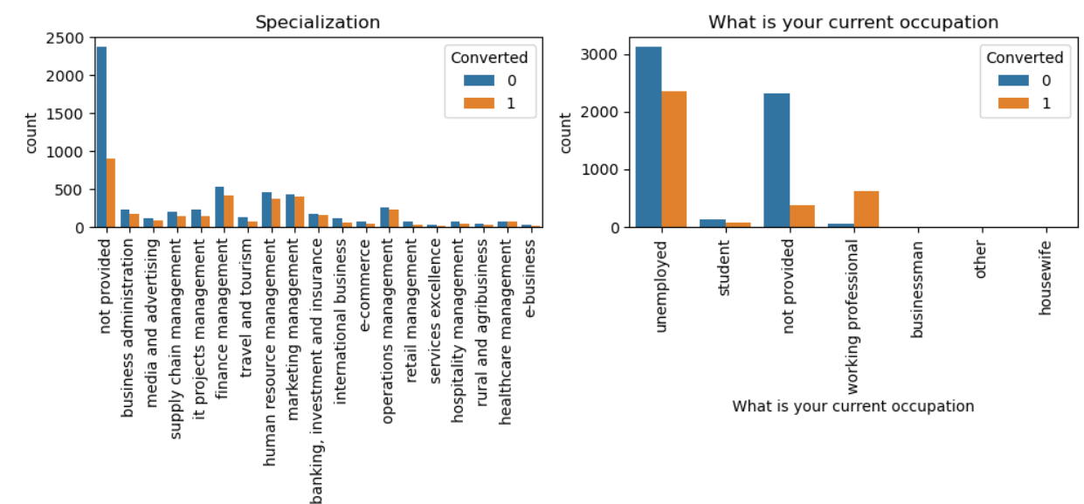

Slide 10
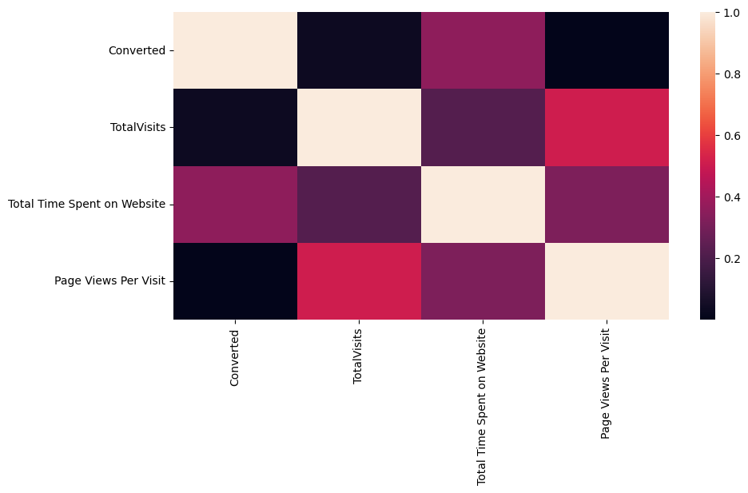
Correlation among variables

Slide 11
Data Conversion
The normalization of numerical variables.
For variables of the object type, dummy variables are made.
Total Rows for Analysis: 8792
Total Columns for Analysis: 43

Slide 12
Model building
Dividing the data into sets for testing and training
Regression analysis begins with a train-test split, of which a 70:30 ratio has been selected.
For feature selection, use RFE.
Building the model by deleting the variable whose p-value is more than 0.05 and vifvalue is larger than 5 after running an RFE with 15 variables as the outcome
Forecasts using the test data set
Total accuracy of 81%

Slide 13
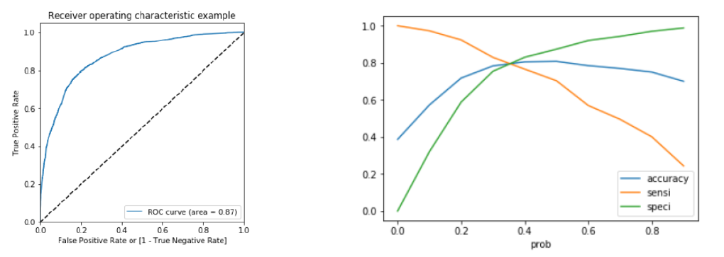
Roc curve
Identifying the Ideal Cutoff Point
The probability at which we achieve a balance between sensitivity and specificity is known as the optimal cut off probability.
It is evident from the second graph that the ideal cut off point is at 0.35.

Slide 14
conclusion
It was discovered that the following factors, in descending order, were the most important to the potential buyers:
The total time spend on the Website.
Total number of visits.
When the lead source was:
Google
Direct traffic
Organic search
Welingak website
When the last activity was:
a. SMS
b. Olark chat conversation
when Lead add format is the lead origin.
when they are employed as a working professional at the moment. With this in mind, X Education can grow since they have a great possibility of persuading nearly every prospective customer to alter their mind and purchase their courses.

